Slide 1



PROJECT NAME-(CARBON EMISSION PREDICTION)
NAME – SHIVA KUMAR SINGH
AICTE STUDENT ID- STU680e7503f303a1745777923
GITHUB Link :-https://github.com/shiva97446/Carbon-Emission-Prediction...git

Slide 2

Learning Objectives
1.Understand and Analyze Historical CO₂ and GHG Data
Examine long-term emission records to identify patterns across countries and time periods.
2.Preprocess and Prepare Data for Machine Learning
Handle missing values, normalize features, and shape the dataset for effective modeling.
3.Apply AI/ML Techniques to Environmental Data
Implement supervised learning algorithms to train predictive models on CO₂ emission data.
4.Perform Country-Specific and Global Emission Forecasting
Predict future carbon emissions for individual countries or global trends using historical inputs.
5.Gain Proficiency with Key Data Science Libraries
Use Python libraries like pandas, matplotlib, and scikit-learn to manage and analyze data.
6.Interpret and Communicate Model Outputs
Visualize predictions and explain their meaning using graphs, charts, and summary metrics.
7.Promote Sustainability Through Tech Skills
Understand how data-driven insights can support climate action and environmental decision-making.
GOAL
Source :
https://github.com/shiva97446/Carbon-Emission-Prediction...git

Slide 3
Tools and Technology used
Programming Language
Python 3.10.4 – For data analysis, modeling, and visualization.
Libraries & Frameworks
Pandas – For data manipulation and preprocessing & Seaborn – For creating insightful visualizations
Scikit-learn – For implementing machine learning algorithms
NumPy – For efficient numerical operations
Matplotlib Machine Learning
Algorithm Used: Linear Regression
Tool Used: Scikit-learn for building and evaluating ML models
Development Environment
VS Code – For writing, testing, and debugging Python code
Dataset
Carbon Emissions Data – Collected from public repositories

Slide 4
Methodology :
Data Collection
Downloaded historical CO₂ and GHG emission data from reliable sources such as government portals and open datasets.
Data Cleaning & Preparation
Removed duplicate or incorrect entries and formatted the data to make it suitable for analysis and model training.
Missing Value Handling
Managed missing data by filling values using averages (mean/median) or by removing incomplete rows and columns.
Feature Selection
Identified and selected key features like Year, Country, Sector, and Emission Levels.
Removed unnecessary or unrelated data based on relevance and data analysis.
Model Building
Trained a machine learning model (e.g., Linear Regression) to learn from historical trends and predict future emissions.
Model Testing
Evaluated the model’s performance using test data and metrics to check how accurate the predictions were.
Visualization
Displayed the predicted emission results using graphs and charts to easily understand future trends and patterns.

Slide 5
Problem Statement:
Accurately forecasting carbon emissions is crucial for understanding climate change and planning mitigation strategies. Using the historical greenhouse gas emissions dataset (country-level CO₂ and GHG emissions from 1750 to 2017), this project aims to develop a predictive machine learning model that can estimate future emission levels. The model can be used to predict a country’s annual carbon emissions or analyze global emission trends based on past data.

Slide 6
Solution:
To address the challenge of forecasting carbon emissions, climate data was collected from public sources and thoroughly cleaned to remove (errors)inconsistencies.Relevant features such as year, GDP, population, energy usage, etc are extracted and selected then we explored that data .After that a machine learning model was trained by using machine learning algorithms (e.g., Linear Regression, Decision Trees) to predict future carbon emissions. Finally, the predicted results were visualized using graphs, enabling clear interpretation of emission trends and supporting data-driven environmental policy decisions.

Slide 7
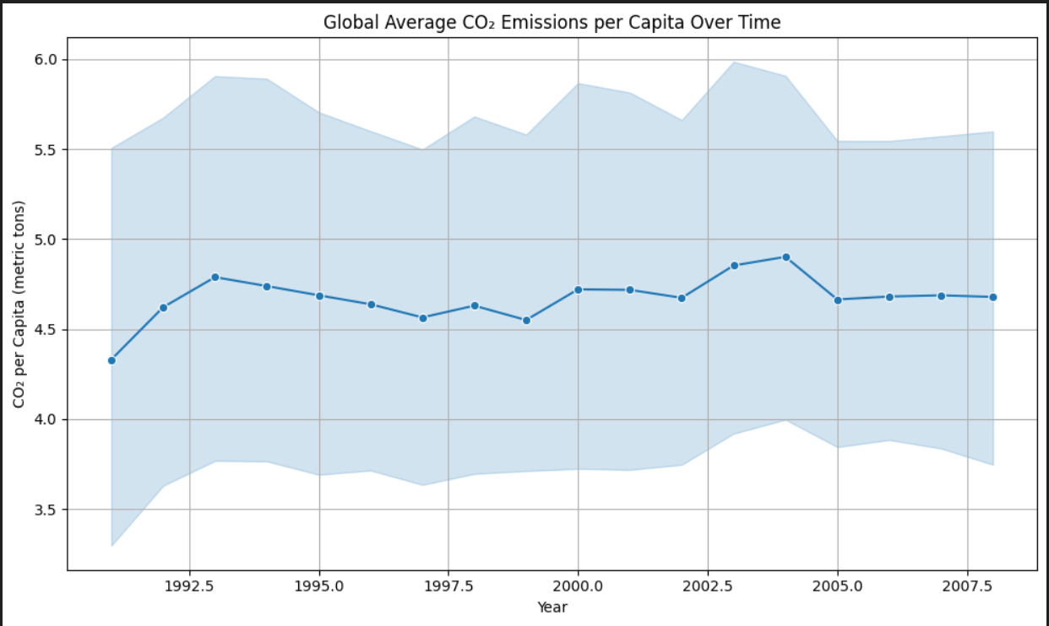
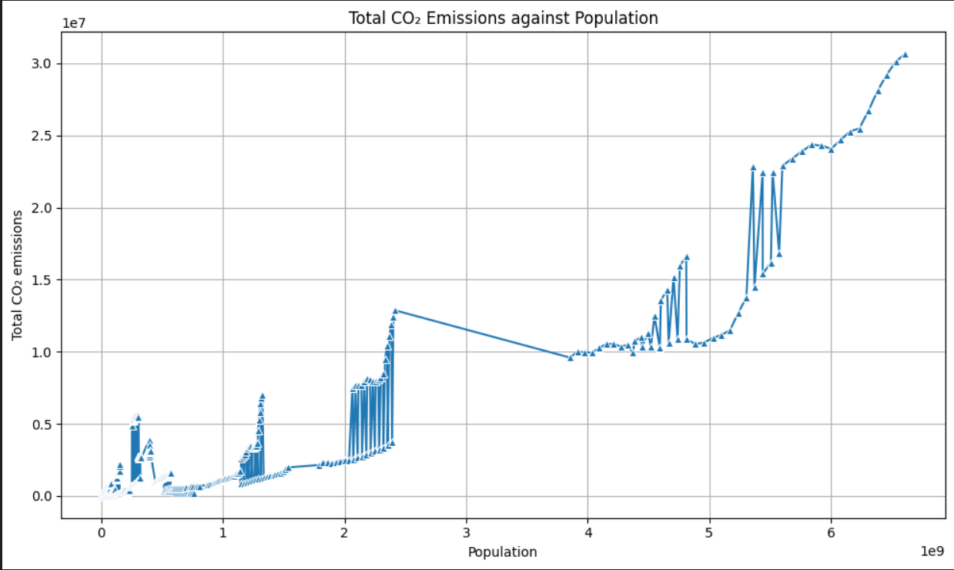
Screenshot of Output:

Slide 8
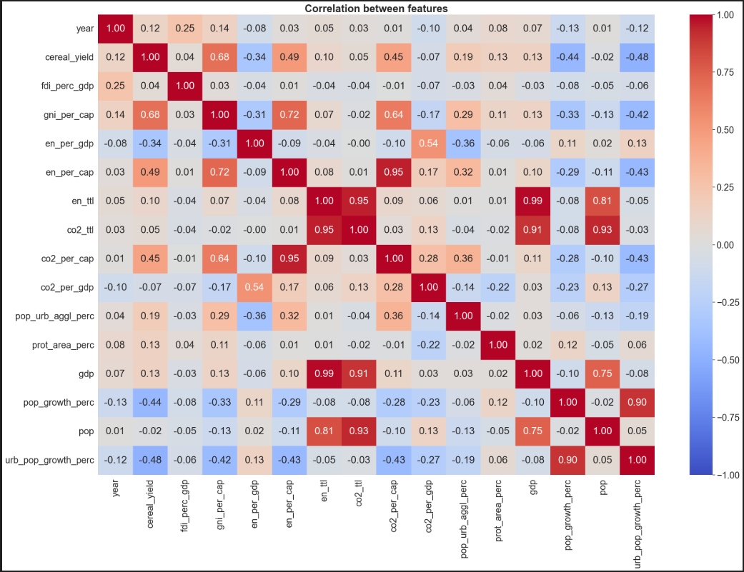

Slide 9
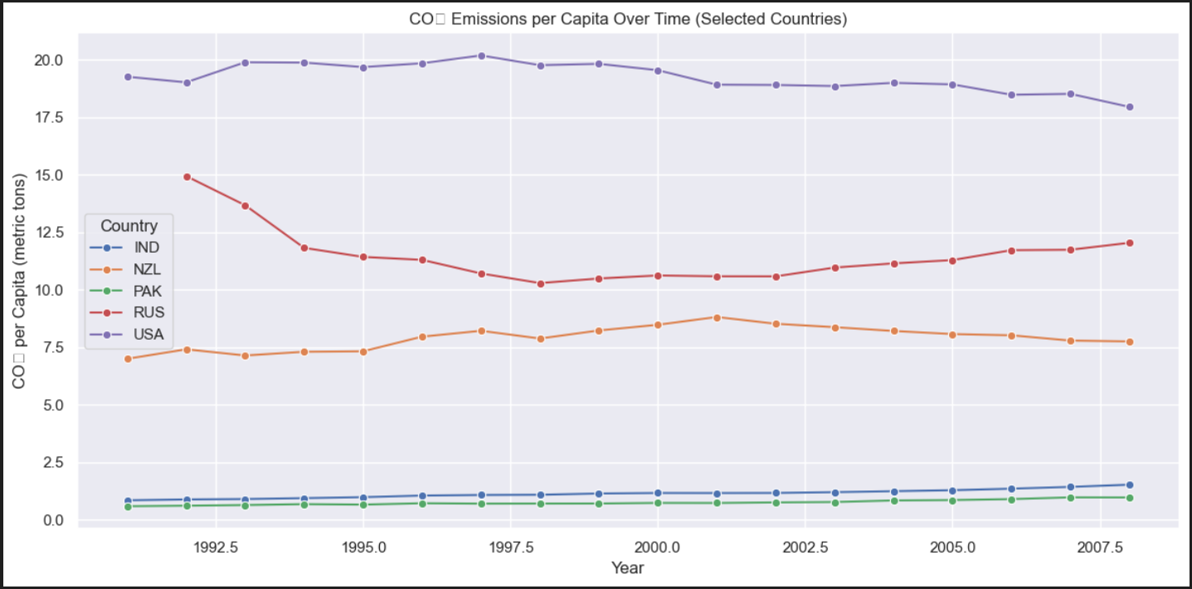

Slide 10
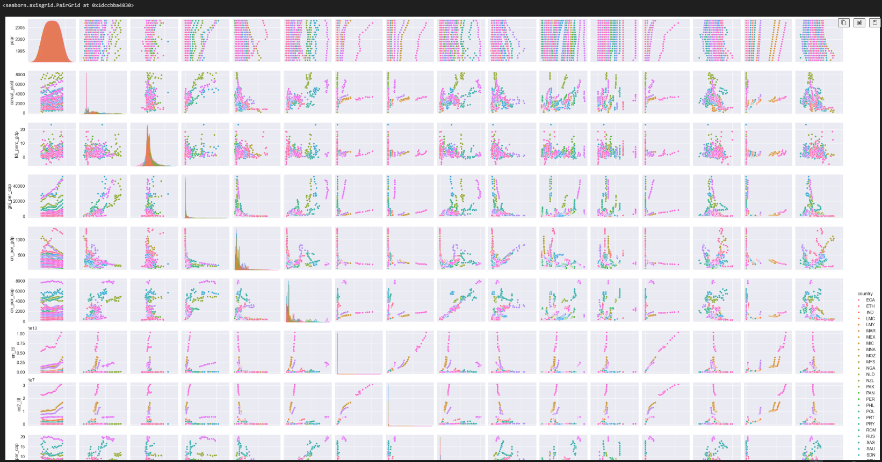

Slide 11
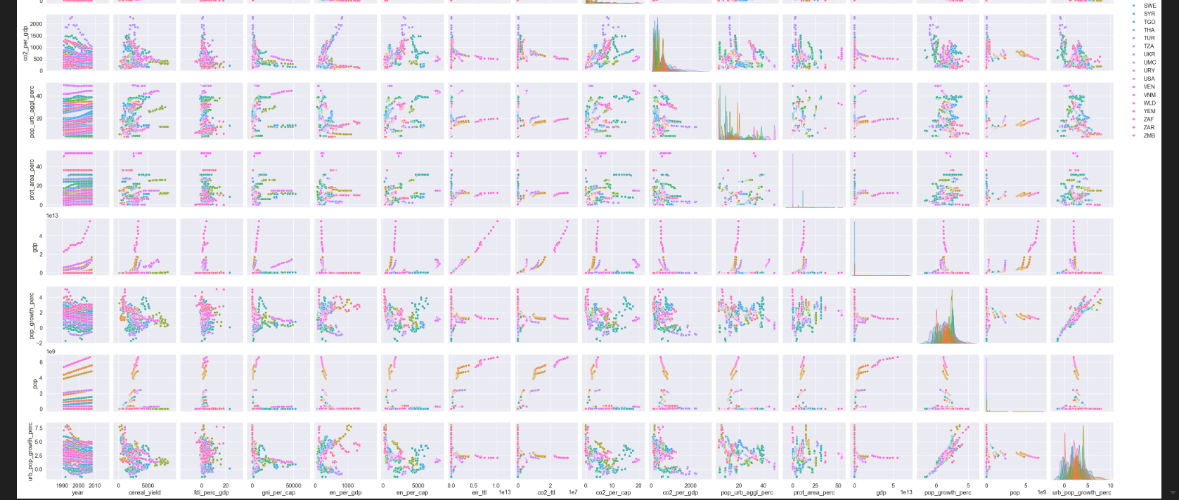

Slide 12
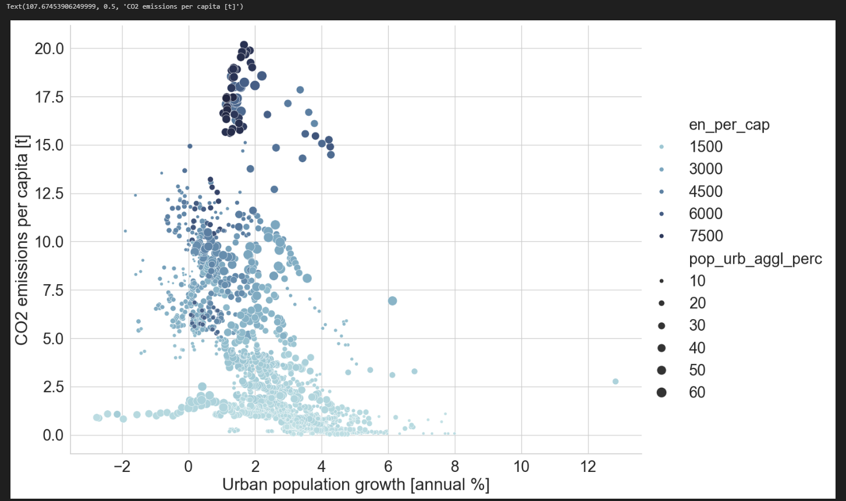

Slide 13
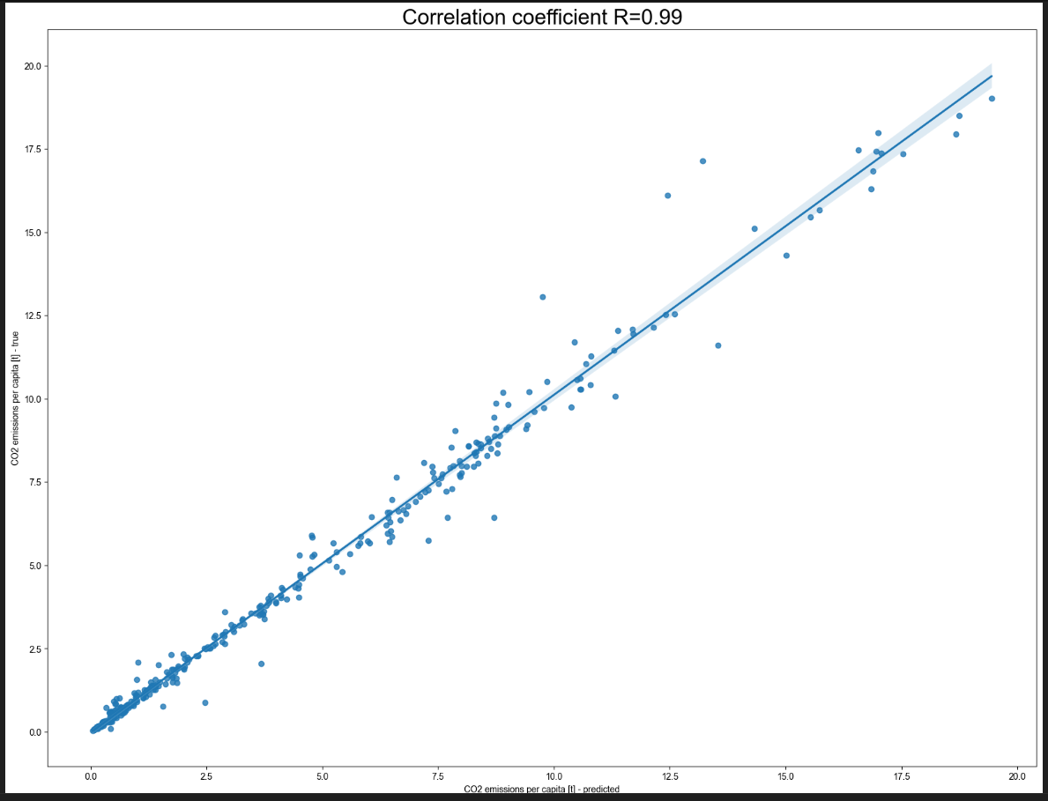
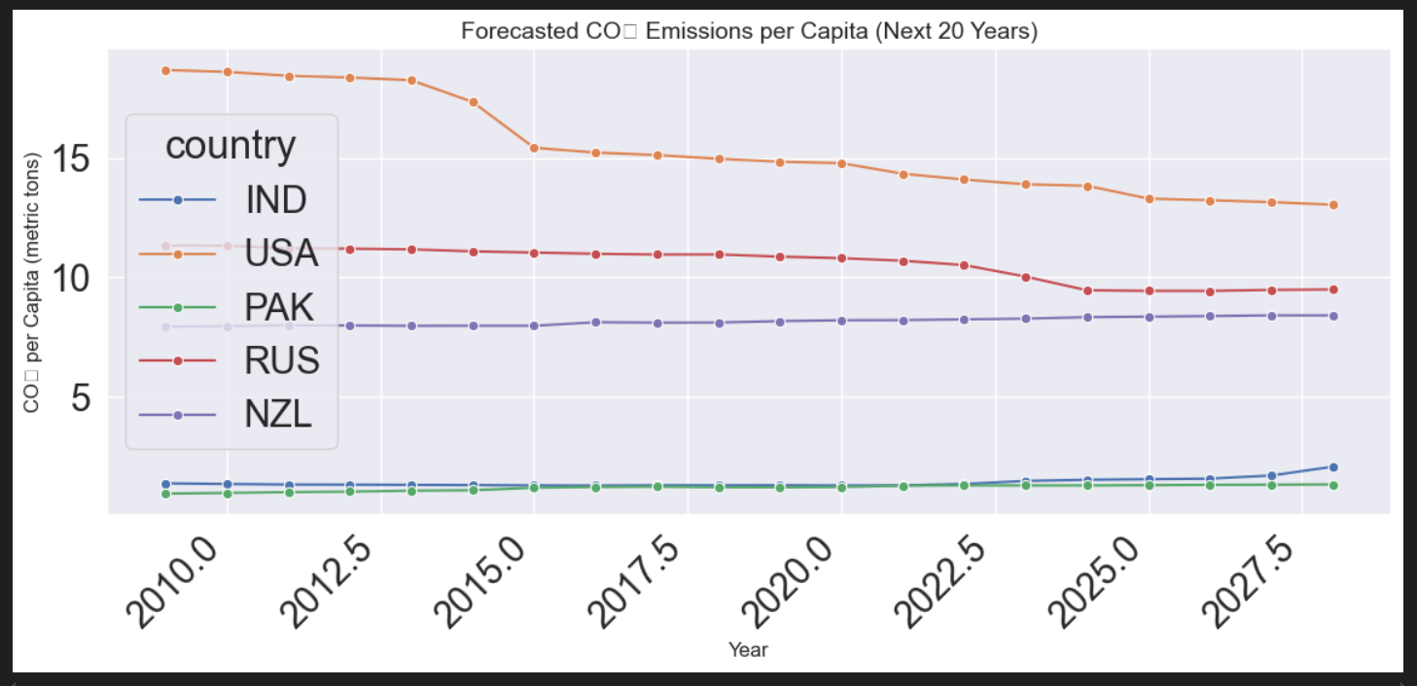

Slide 14
Conclusion:
In conclusion, the growing concern over rising carbon emissions and their impact on climate change highlights the urgent need for accurate forecasting tools. This project successfully addressed that need by developing a machine learning model using historical greenhouse gas emission data to predict future CO₂ levels. Through proper data collection, cleaning, feature selection, and model training, the system provides valuable insights into emission trends at both national and global levels. These predictions, visualized through clear graphs, can support policymakers, researchers, and environmental planners in making informed, data-driven decisions to combat climate change effectively.

